Slide 1
Section 7 – Let’s Make Charts!
Charts and plots and graphs, oh my!

Slide 2
Chart Types
First, decide how to present your data
Are you looking to show:
Trend over time
Composition
Compare / contrast
Distribution
Relationships
Often, I find it most useful to sketch out on paper what I want to see beforehand!

Slide 3
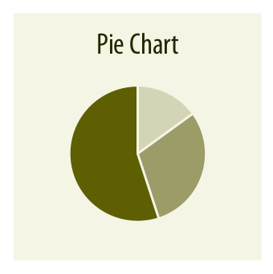
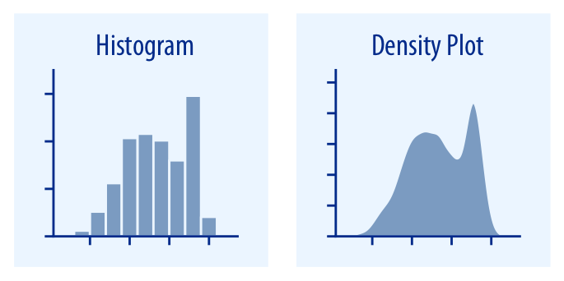
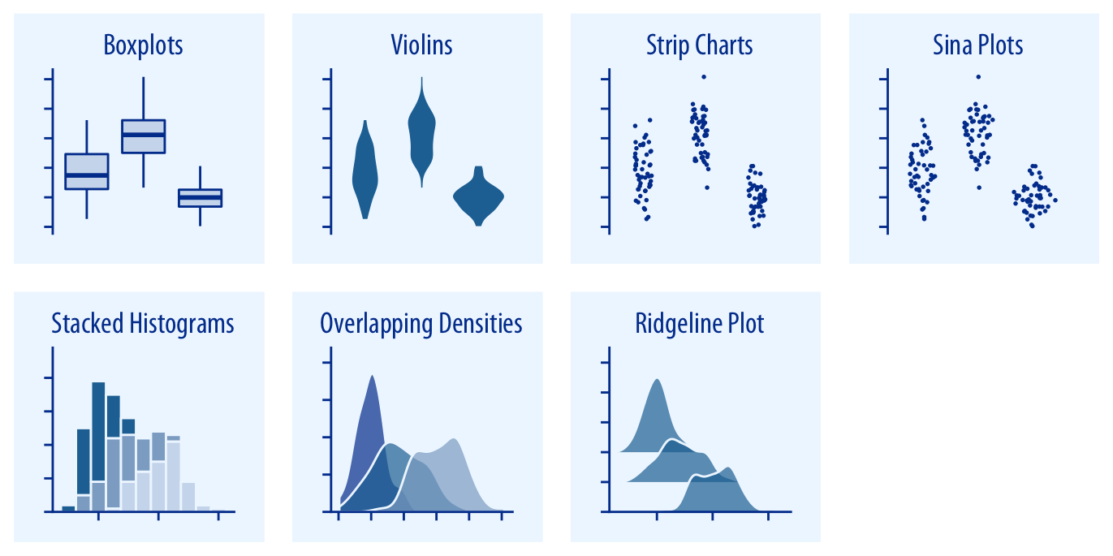
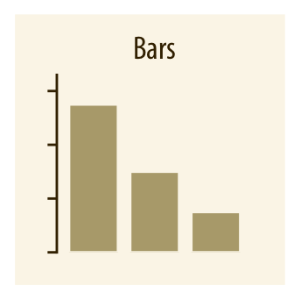
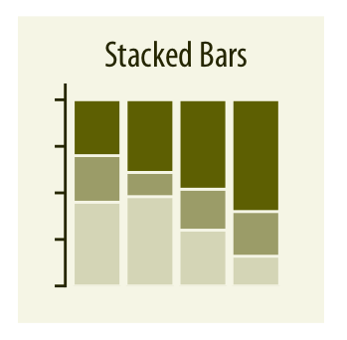
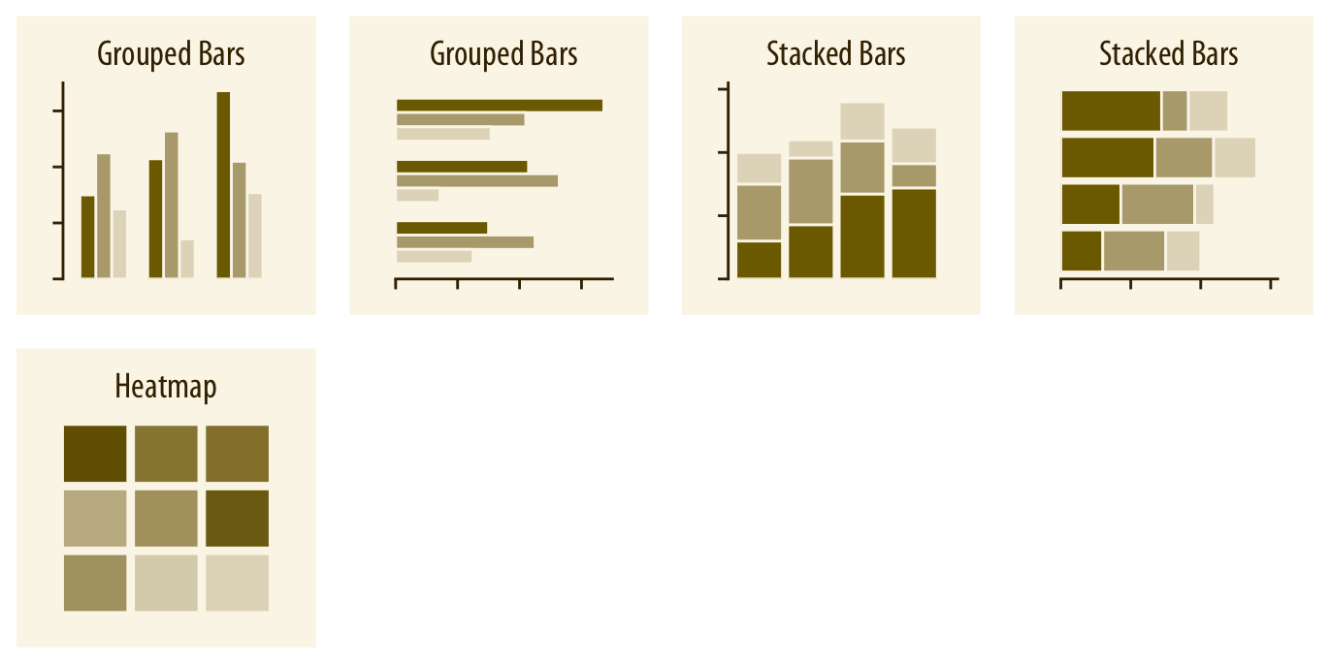
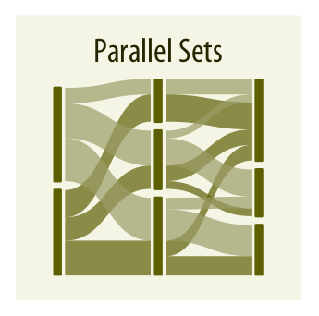
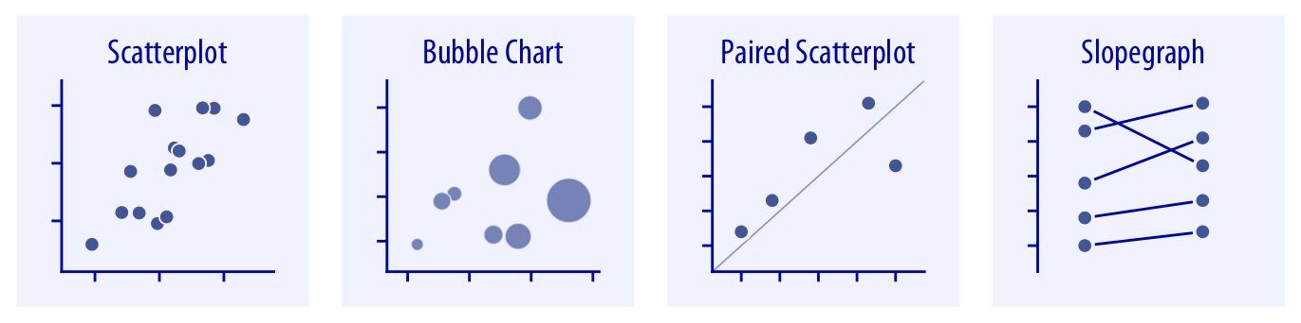
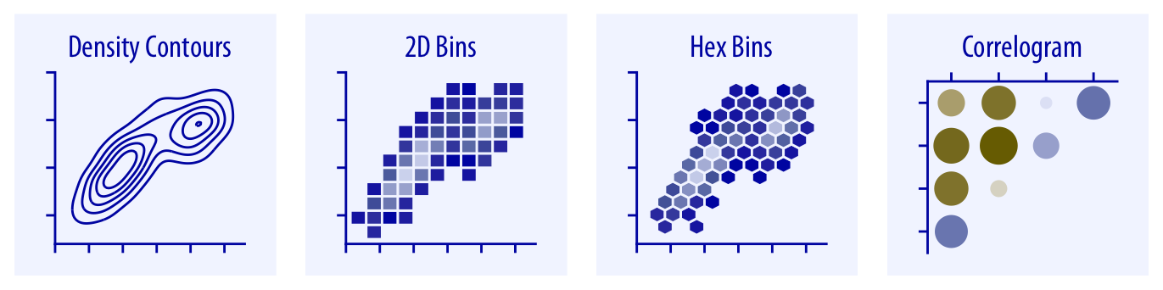
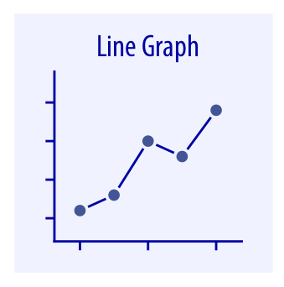
Chart Types
Proportion
Distributions
Amounts
X-Y Relationships
Based on the book Fundamentals of Data Visualization

Slide 4
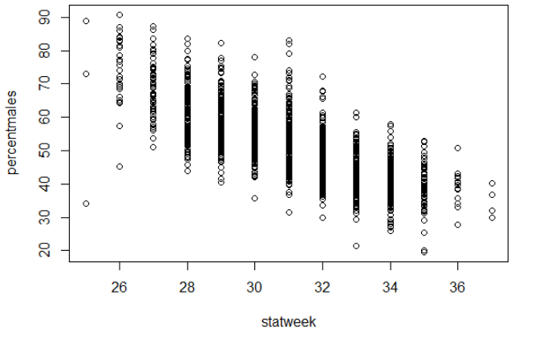
Base R Plot Basics
Use base function plot()
Syntax is plot(yaxiscolumn ~ xaxiscolumn, data = dataname)
OR alternately: plot(x = dataname$xaxiscolumn, y = dataname$yaxiscolumn)
Using plot() is very quick and easy!
plot(percentmales ~ statweek, data = pinkratio)

Slide 5
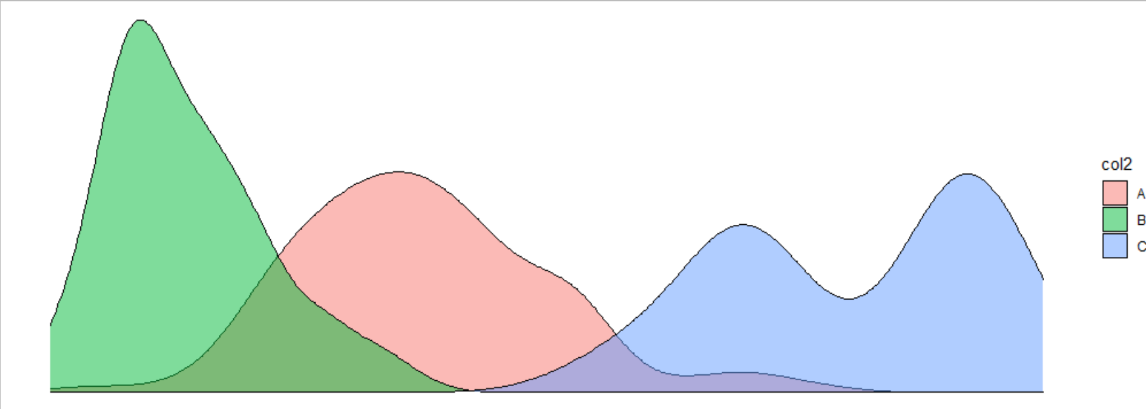
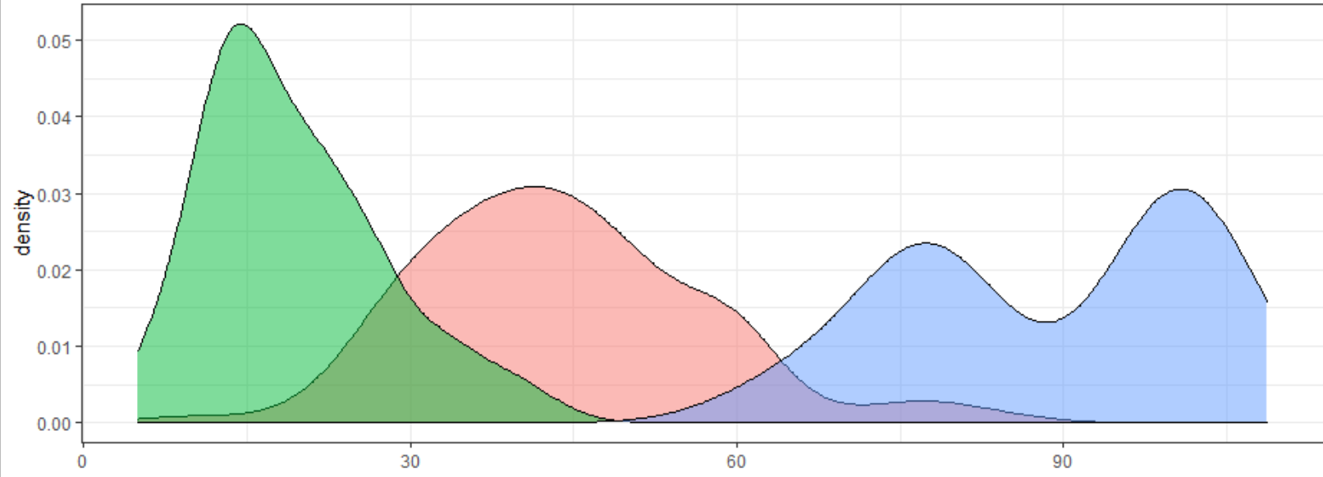
ggplot2 – A Modern Plot Solution
Why use ggplot2 over base plot?
Faster to make beautiful charts
Easier to make complicated chars
I’ll call it just ggplot. What happened to ggplot1? Nobody knows…..
Notes:
ggplot2 is part of the “tidyverse” group of packages that we’ve been using

Slide 6

ggplot2 roadmap
ggplot() function with data & aes()
aes() is the “aesthetics”. Set which cols are equal to x, y, color, fill, and group.
Use a “+” to connect between lines
Control aspects of the chart with “scale_”, e.g., scale_y_continuous
Add points & lines using “geom_”
e.g., geom_point(), geom_line(), etc
Establish the plot
ggplot(data = mydataframe, aes(x = xcolumn, y = ycolumn))
scale_x_continuous(breaks = c(1990, 2000, 2010, 2020)) +
geom_line()
+
Control x axis (e.g., set axis breaks)
Create lines!
Notes:
We build up a ggplot object layer by layer
This is a roadmap to the topics that we’ll discuss here shortly: we’re going to talk about the aes() function, what geoms are,
A grouping variable would be analogous to “series” in Excel. For example, if you want multiple lines, tell ggplot what column you want it based on. Maybe a different line for each river

Slide 7
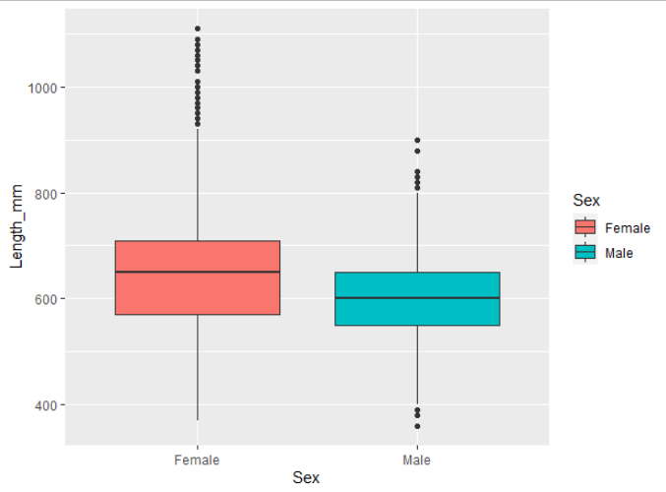
Anatomy of a ggplot
Establish which dataframe to look at
ggplot(data = sablefish,
aes(x=Sex, y = Length_mm,
fill = Sex)) +
geom_boxplot()
ggplot(data = sablefish,
aes(x=Sex, y = Length_mm,
fill = Sex)) +
geom_boxplot()
“Sex” should be along x-axis, with length on y
Fill the objects based on the Sex column
Three required parts:
ggplot(data = xxx, aes()) +
geom_xxx()
Create a boxplot!
Notes:
Note also that our plot must be internally consistent! What if variable “Sex” was a numeric variable instead of a categorical? We couldn’t make a boxplot

Slide 8
ggplot parts: ggplot()
Required ggplot parts: data and aesthetics
Establish data using data =
Use aesthetics to “map” different variables to the x-axis, y-axis, fill, color, group (series), etc.
Done within the aes() function
Technically, specifying the data and the aes() could happen within the geom_xxx()
ggplot(data = mydataframe,
aes(x = xcolumn, y = ycolumn, group = groupingvariable))
The aes() function can contain other parts:
shape = variable,
fill = variable,
color = variable,
alpha = variable

Slide 9
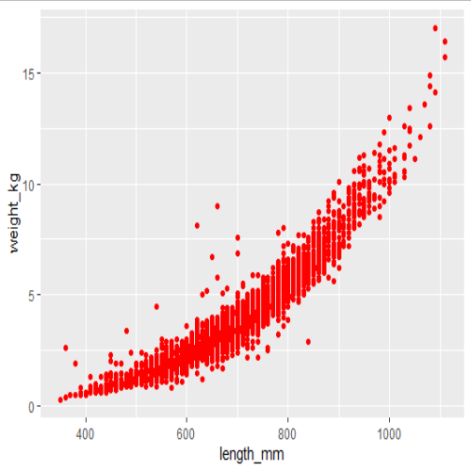
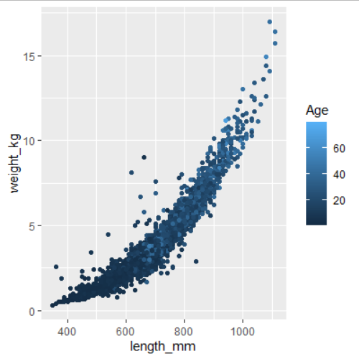
ggplot parts: aes()
It can be tricky to wrap your head around the aes function
Make sure to keep the aes() inside the ggplot()
Anything that is static goes OUTSIDE the aes(), in geom
Anything dynamic (changes according to a variable) goes INSIDE the aes()
Static: color does not change
Dynamic: color changes by variable
ggplot(sablefish, aes(x=length_mm, y = weight_kg)) +
geom_point(color = "red")
ggplot(sablefish, aes(x=length_mm, y = weight_kg, color = Age)) +
geom_point()

Slide 10
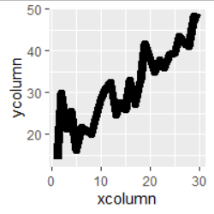
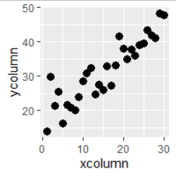
ggplot parts: geoms
Last required piece is the “geom” where you tell ggplot what kind of plot you’d like:
Ex: geom_line() make line plot
geom_point() makes scatterplot
ggplot(data = dfname,
aes(x = xcol, y = ycol)) + geom_line()
geom_line()
geom_point()
geom_point()
Notes:
Reference guide: http://sape.inf.usi.ch/quick-reference/ggplot2/geom

Slide 11
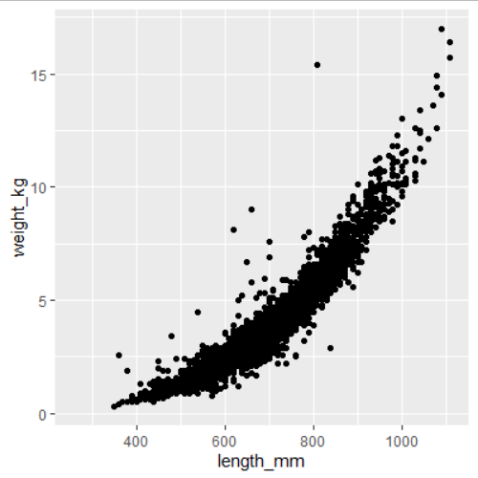
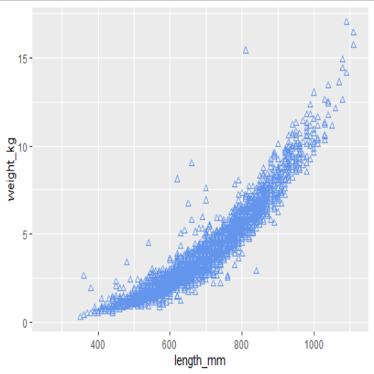
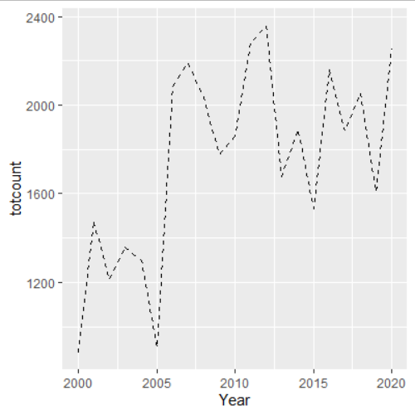
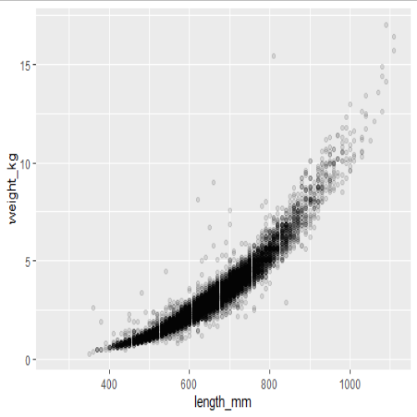

ggplot parts: geoms
To modify this plot, common arguments within a geom are:
color
shape (only for geom_point)
alpha (transparency)
linetype (only for geom_line)
ggplot(sablefish, aes(x=length_mm, y = weight_kg)) +
geom_point()
ggplot(sablefish, aes(x=length_mm, y = weight_kg)) +
geom_point(color = "cornflowerblue")
ggplot(sablefish, aes(x=length_mm, y = weight_kg)) +
geom_point(color = "cornflowerblue", shape=2)
ggplot(sablefish, aes(x=length_mm, y = weight_kg)) +
geom_point(alpha = 0.1)
ggplot(data = totalsablefish, aes(x=Year, y = totcount)) +
geom_line(linetype = “dashed”)
Notes:
Notice that none of these are within the aes()

Slide 12
ggplot parts
So far, so good! These are the minimum parts required of a ggplot
ggplot(data = dataframename, aes(x=xcolumn, y=ycolumn)) + geom_xxx()
Let’s head to RStudio to practice making the basics!
Now we’ll learn about adding more parts
Add lines together with a “+”

Slide 13
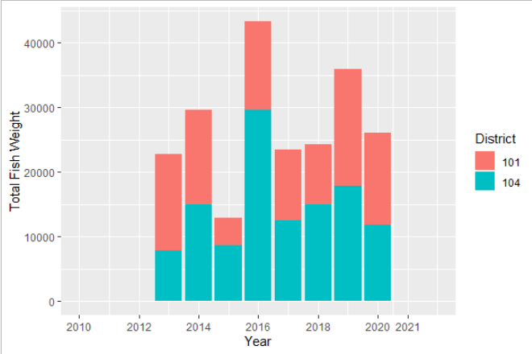
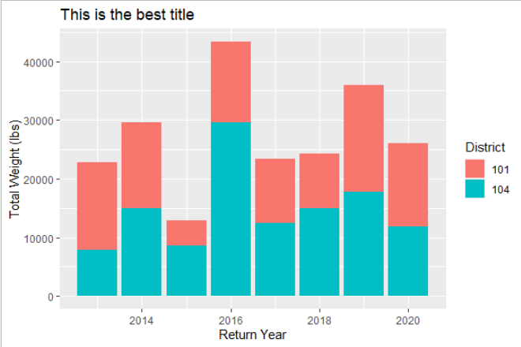
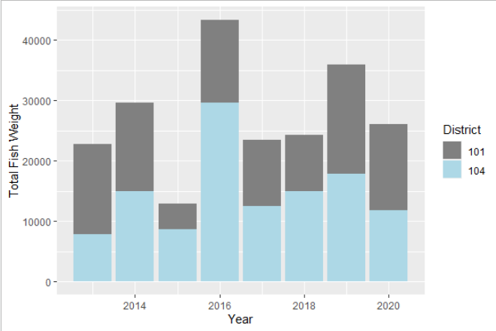
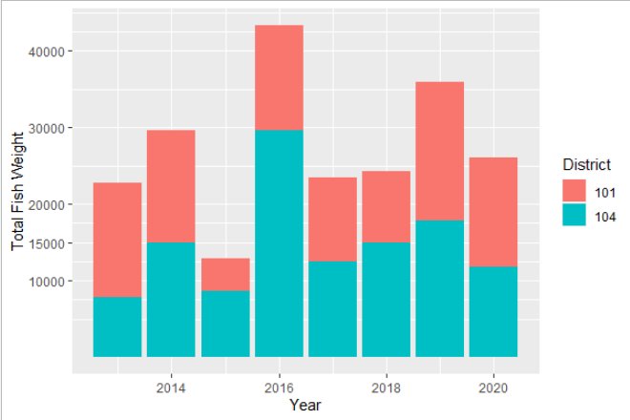

ggplot parts: scales
What if we want to clean up the plot, specify colors, change axis labels, etc.?
The scale_ family are optional helper functions to specify variable colors, variable fills, axis range / breaks, etc.
Far too many to review
To change axis labels or title, use labs()
labs(x = "Return Year", y = "Total Weight (lbs)", title = "This is the best title")
expand_limits(x = c(2010, 2022)) +
scale_x_continuous(breaks = c(2010, 2012, 2014, 2016, 2018, 2020, 2021))
No modified scales
scale_y_continuous(breaks = c(10000, 15000, 20000, 30000, 40000))
scale_fill_manual(values = c("#808080", "lightblue"))
Notes:
There are too many types of scales to list.

Slide 14
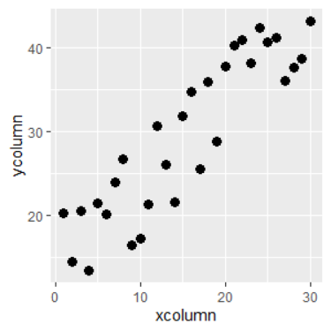
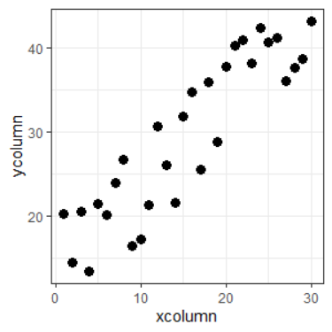
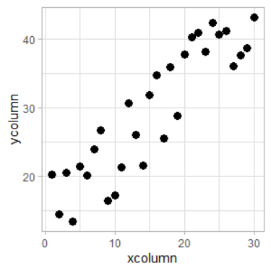
ggplot parts: theme
To modify the appearance of text, axis lines, legend, etc., use theme()
There are several built in themes
theme_bw()
theme_minimal()
theme_light()
I never remember how to do most theme modifications and google it
default
theme_bw()
theme_light()

Slide 15
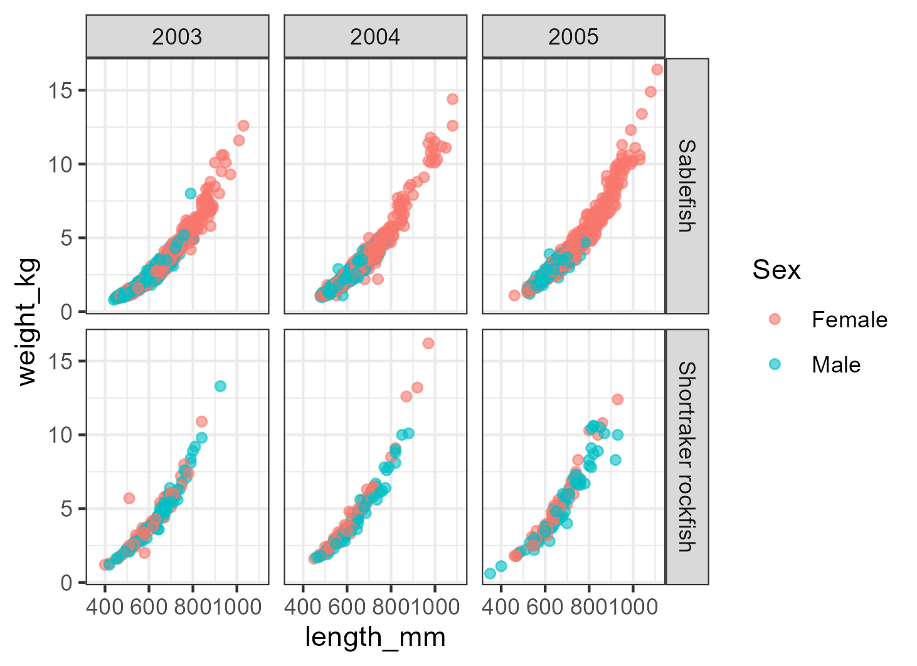
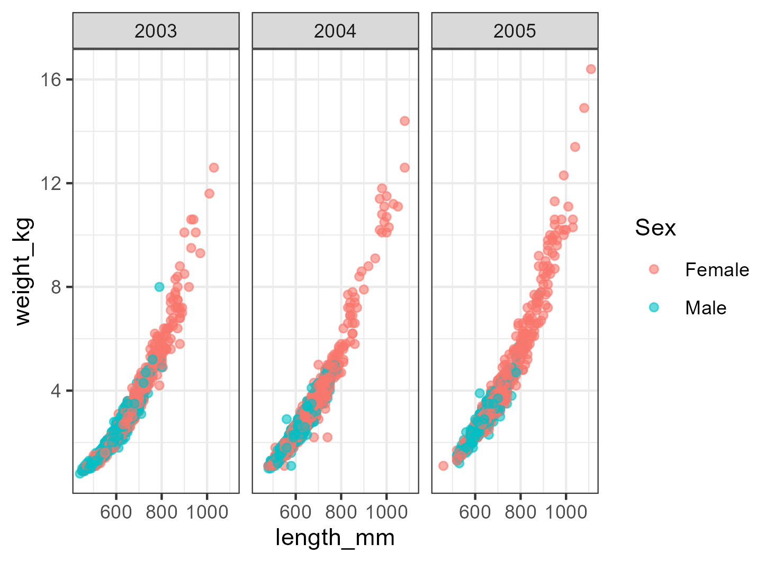
ggplot parts: facets
One amazing feature of ggplot is the ability to create a different plot for specific subsets of a variable
Use command facet_wrap(~variable) or facet_grid(~variable)
You can also facet it based on two variables:
facet_wrap(variable1 ~ variable2)
facet_grid(~Year)
facet_grid(Species ~ Year)
Notes:
CODE (for 2nd plot): groundfish %>% filter(between(Year, 2003, 2005), Species %in% c("Shortraker rockfish", "Sablefish"), Sex %in% c("Male", "Female")) %>% ggplot(aes(x = length_mm, y = weight_kg, color = Sex)) + geom_point(alpha = 0.6) + facet_grid(Species ~ Year) + theme_bw()

Slide 16
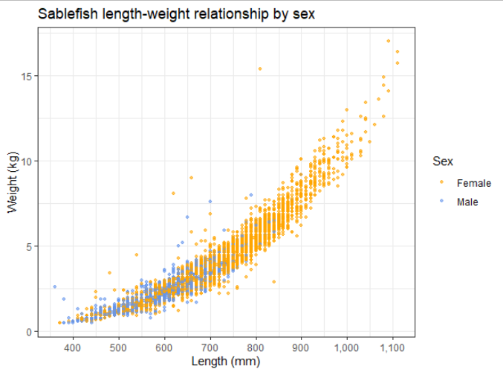
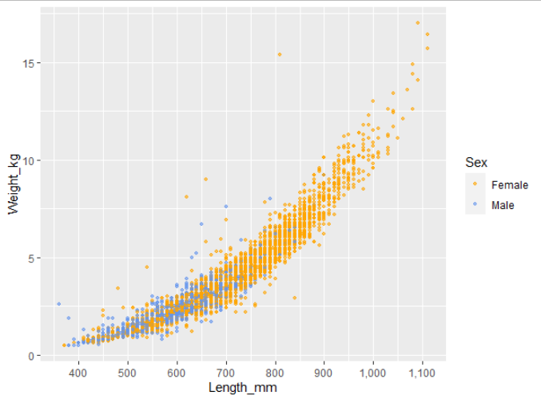
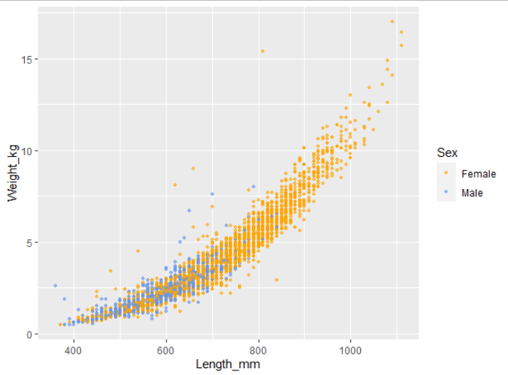
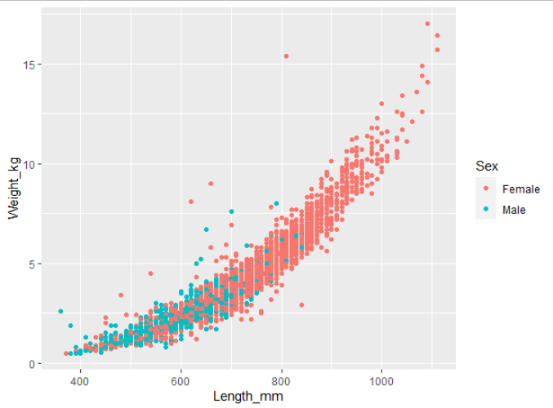

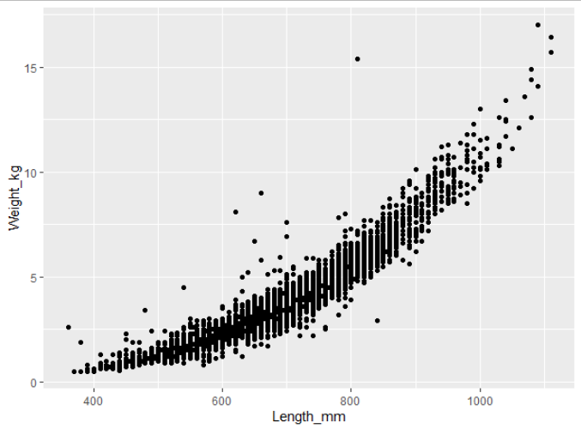
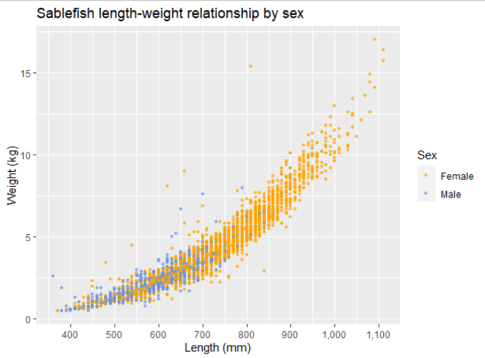
Anatomy of a ggplot
> ggplot(data = sablefish, aes(x = Length_mm, y = Weight_kg)) +
geom_point()
> ggplot(data = sablefish,
aes(x = Length_mm,
y = Weight_kg,
color = Sex)) +
geom_point(size = 0.9, alpha = 0.6) +
scale_color_manual(values =
c("orange", "cornflowerblue")) +
scale_x_continuous(breaks = c(400,
500, 600, 700, 800, 900, 1000,
1100, 1200), labels = scales::comma) +
labs(x = "Length (mm)", y = "Weight(kg)",
title = "Sablefish length-weight
relationship by sex")
> ggplot(data = sablefish,
aes(x = Length_mm,
y = Weight_kg,
color = Sex)) +
geom_point(size = 0.9, alpha = 0.6) +
scale_color_manual(values =
c("orange", "cornflowerblue")) +
scale_x_continuous(breaks = c(400,
500, 600, 700, 800, 900, 1000,
1100, 1200), labels = scales::comma) +
labs(x = "Length (mm)", y = "Weight(kg)",
title = "Sablefish length-weight
relationship by sex") +
theme_bw()
> ggplot(data = sablefish,
aes(x = Length_mm,
y = Weight_kg,
color = Sex)) +
geom_point(size = 0.9, alpha = 0.6) +
scale_color_manual(values =
c("orange", "cornflowerblue")) +
scale_x_continuous(breaks = c(400,
500, 600, 700, 800, 900, 1000,
1100, 1200), labels = scales::comma)
> ggplot(data = sablefish,
aes(x = Length_mm,
y = Weight_kg,
color = Sex)) +
geom_point(size = 0.9, alpha = 0.6) +
scale_color_manual(values =
c("orange", "cornflowerblue"))
> ggplot(data = sablefish,
aes(x = Length_mm,
y = Weight_kg,
color = Sex)) +
geom_point()
> ggplot(data = sablefish,
aes(x = Length_mm,
y = Weight_kg,
color = Sex)) +
geom_point(size = 0.9, alpha = 0.6)
Notes:
Predict what next plot will be!

Slide 17
Plotting Approach
When starting out, it’s tempting to paste a lot of code from a previous figure or something you found online.
If you can, try not to do this. A better approach is to build it step by step, line by line.
Add just the skeleton, e.g., ggplot(aes()) + geom_line(), and build out
This will immediately identify where errors exist

Slide 18
Fill vs Color
Remember to keep in mind the difference between “fill” and “color”
“Fill” fills in an area (bar column)
“Color” is the point or line
If specifying manually, these take different commands depending on discrete vs continuous data
FILL an area
COLOR a line or point

Slide 19

Saving!
If you want to save your ggplot, save to environment and use ggsave()
plotname <- ggplot(dfname, aes(x = xcol, y=ycol)) +
geom_point()
ggsave(plot = plotname,
filename = "output/filesavename.png", dpi = 300,
width = 6,
height = 4,
units = "in")
Object name
Dots per inch (≥300)
Set width, height and
what units you’re using

Slide 20

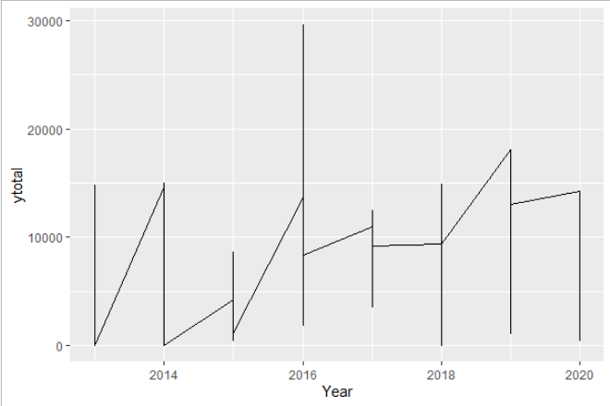

Common ggplot errors
The most common errors I see are:
What goes inside vs outside aes()
Items inside aes() are variables (changeable), outside are static
Jagged lines
You have multiple y points for each x point. Add a “group = ___” to plot a line for each group
Color vs Fill
Easy mistake, remember the difference
Overwriting a theme
ggplot will use the last theme settings you gave it
ggplot(dfname, x=xname, y=yname, aes(color=groupname))
ggplot(dfname, aes(x=xname, y=yname, color=groupname))
Fill an area
Color line / point
ggplot(dfname, x=xname, y=yname, aes(color=groupname)) +
theme(line = element_blank()) +
theme_minimal()
Notes:
(The white box is just to improve printing)

Slide 21
Resources
The following slides are additional to what we’ll cover in class but helpful as reference material to review in the future!

Slide 22
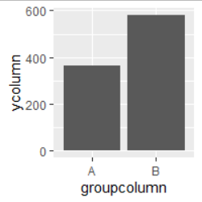
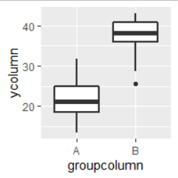
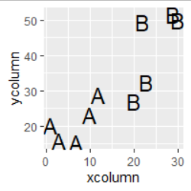
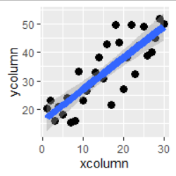
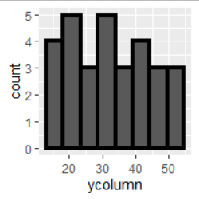
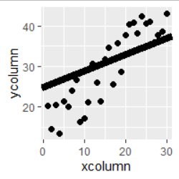
ggplot parts: geoms
Plot Type & Notes:
Tell ggplot what kind of plot you’d like:
Basic scatterplot. Typical arguments
Basic line. Typical arguments
Scatterplot but use text instead of symbols.
Add linear or LOESS smoothing. Use method = “lm” or method = “loess”
Basic bar (columns). “fill” is the bar color, color is bar outline
geom_point()
geom_line()
geom_col()
geom_boxplot()
Add a boxplot, x is categorical
Histogram. No y-axis specified in aes()
Add straight line with arguments slope = 1, intercept = 0.
geom_text()
geom_point() + geom_smooth()
geom_histogram()
geom_point() + geom_abline()
Notes:
Reference guide: http://sape.inf.usi.ch/quick-reference/ggplot2/geom

Slide 23
ggplot parts: theme
Some common theme() changes:
Rotate x axis text
Increase font size & change font
Move legend position & remove legend title
theme(axis.text.x = element_text( angle = 45, vjust=1, hjust=1)
library(extrafont)
theme(base_size = 12, base_family = “Arial”)
theme(legend.position=c(0.5, 0.05), legend.title = element_blank())

Slide 24
Fill vs color
 | Color | Fill
Continuous | scale_color_gradientn(colors = c()) | scale_fill_gradientn(colors = c())
Categorical | scale_color_manual(values = c(“xxx”)) | scale_fill_manual(values = c(“xxxx”))
Example Code:
scale_color_gradientn(colors = terrain.colors(10))
scale_fill_gradientn(colors = terrain.colors(10))
scale_color_manual(values = c("orange", "cornflowerblue"))
scale_fill_manual(values = c("orange", "cornflowerblue"))
Notes:
Reference only
Mainly, I just want you to know for the future that you need to specify differences between continuous and categorical variables

Slide 25
YouTube Videos about ggplot
If you need another explanation, watch Dr. Lendway’s videos
Intro to ggplot() – 8 min
Common ggplot mistakes – 3 min
ggplot demo – 32 min
These videos support material on her learning website

Slide 26
Base R Plotting Help:
Matt’s non-exhaustive Base-R plotting toolbox:
Plotting functions
plot(…)
boxplot(…)
mosaicplot(…)
Common plotting arguments
col= # color
lwd= # line width
lty= # line type
xlab=, ylab=, main= # axis labels & title
Drawing functions
points(x=, y=, …)
lines(x=, y=, …)
segments(x0=, x1=, y0=, y1=, …) # segments between two vectors of coords
polygon(x=, y=, …)
abline(…) # adds a straight line somewhere
abline(a=0, b=1, …) # intercept=0, slope=1
abline(h=, …), abline(v=, …) # horizontal or vertical lines
abline(lmout, …) # regression line from lm() output
legend(x=, y=, legend=c("thing1", "thing2", "thing3"), …)
can also use legend("topleft" , …) etc, instead of x & y cords
text(x=, y=, labels=, …) # draws text at the coordinates specified
par(…) # sets graphical parameters for plots that follow
par(mfrow=c(2,3)) # plots will be in panes of 2 rows and 3 columns
par(family="serif") # Times New Roman-ish

Slide 27
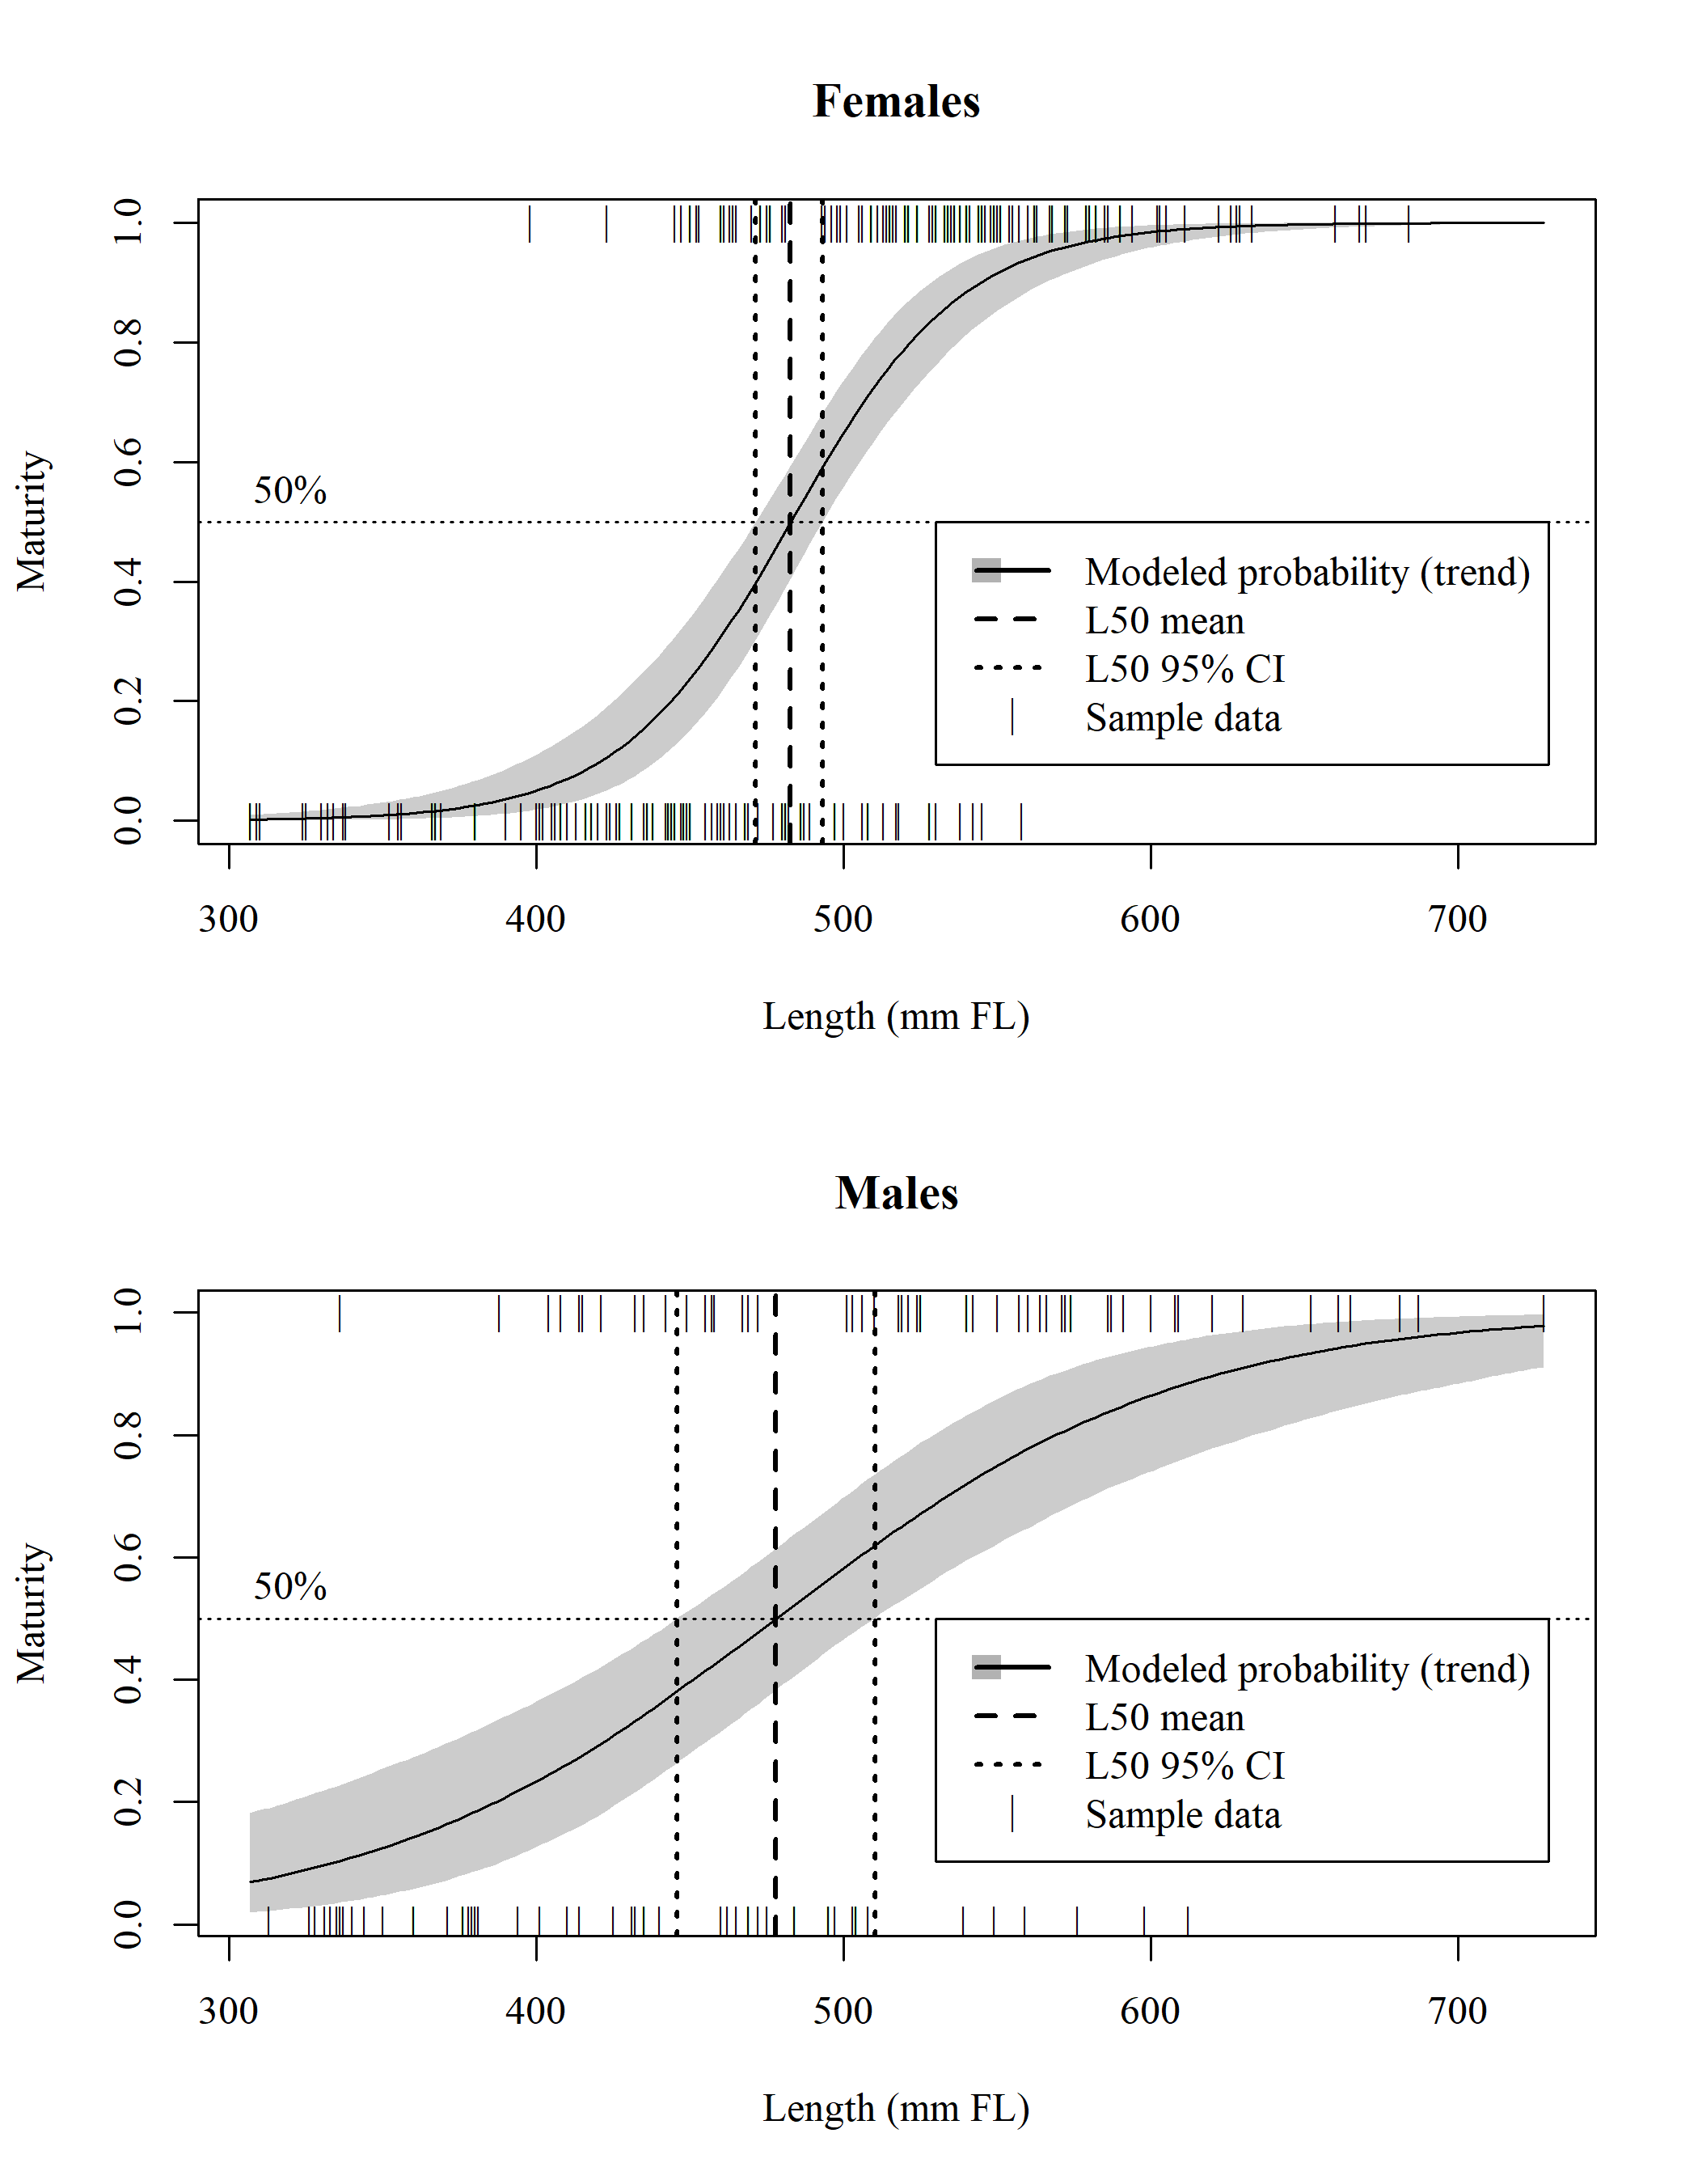
Base R Plotting
Pseudocode is the best code
Set graphical parameters
Two rows, one column
Times New Roman
Use jagshelper::envelope for CI envelopes
Draw points at bottom & top
Draw the lines in the right places
Label the 50% line
Add a legend

Slide 28
Base R Plotting
Pseudocode is the best code
par(mfrow=c(2,1)) # for layout
par(family="serif") # for font
jagshelper::envelope(JAGS output plus axis labels, etc)
for Bayesian interval envelopes
Note that this is a function that produces a new plot
points(x=length, y=maturity, pch="|")
Drawing individual observations of maturity at y=0 or y=1
abline(h=0.5, lty=3)
Dotted line at y=50%
text(x=, y=, labels="50%")
abline(v= est & CI for length at 50% maturity,
lty=2, lwd=c(2, 3, 2))
legend(x=, y=, labels=,
lty=c(1, 2, 2, NA), lwd=c(3, 3, 2, NA),
pch=c(NA, NA, NA, "|"), fill=c("grey", NA, NA, NA))

Slide 29
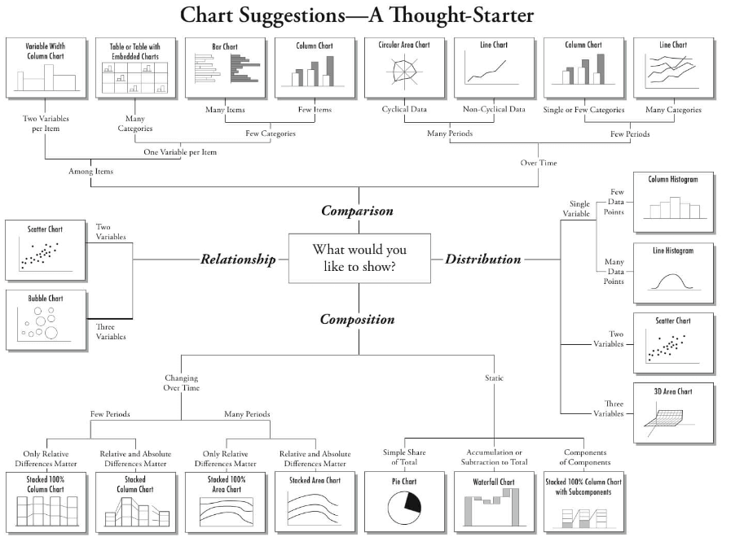
Even More Chart Suggestions (incomplete list)

